Slide 1
Mobile Communications Systems (MCS) GSM system architecture
MSc Telecommunications programmes
Mobile Communications Systems (MCS)
Professor Izzat Darwazeh
October/November 2020

Slide 2
Outline
Part 1 - Morning: GSM System Architecture:
GSM basics
GSM Network Architecture and Components
GSM Radio Interface
GSM Speech Coding
Part 2 - Afternoon: GSM System Operation:
GSM Numbering systems
MO and MT call setup
Handover
SMS
GSM Subscriber Authentication
GSM Roaming

Slide 3
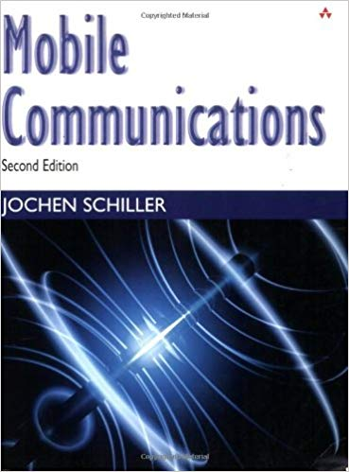
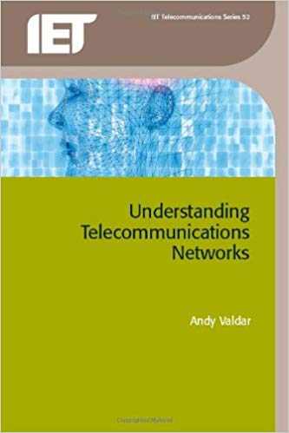
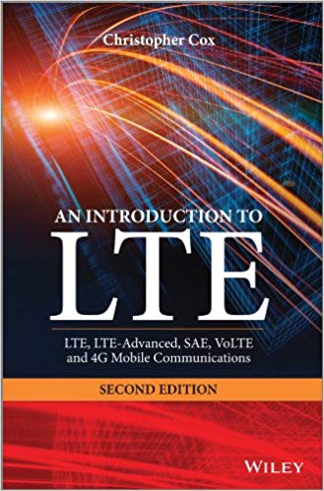
Suggested reference texts

Slide 4
GSM Basics

Slide 5
Background to GSM
GSM was originally the acronym for “Groupe Spéciale Mobile” (circa 1982). Later changed to “Global System for Mobile Communication”
CEPT initiated work on GSM in 1982, ETSI issued the standards in 1990
Pan-European standard (ETSI, European Telecommunications Standardization Institute)
Conceived as a digital system, based on circuit switched telephony, primarily for voice, fax and SMS. IP Data services were later “bolted on” in the form of GPRS.
Designed to enable seamless roaming within Europe (major distinction with previous analog systems).
GSM is now the primary mobile standard in the world with more than 400 operators in more than 130 countries and nearly 4 billion subscribers worldwide.

Slide 6
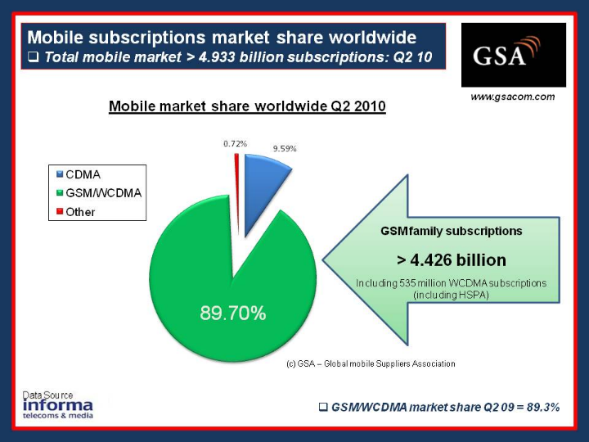
Mobile subscriber growth : Africa
Ref : http://www.gsacom.com/news/statistics.php4

Slide 7
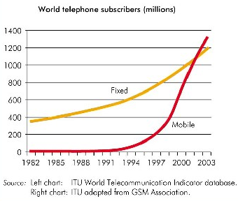
Subscriber Growth
Total world mobile subscribers overtook total fixed line subscribers around 2002
Source : ITU website

Slide 8
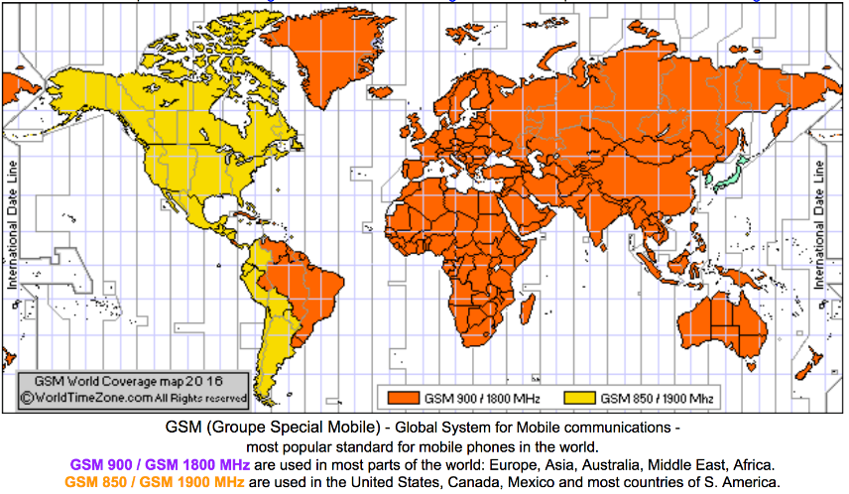
Worldwide map of GSM coverage (2016)
source :http://www.worldtimezone.com/gsm.html

Slide 9
Development of mobile telecommunication systems
CT0/1
FDMA
AMPS
NMT
CT2
IMT-FT
DECT
IS-136
TDMA
D-AMPS
EDGE
IMT-SC
IS-136HS
UWC-136
TDMA
GSM
GPRS
PDC
IMT-DS
UTRA FDD / W-CDMA
HSPA
IMT-TC
UTRA TDD / TD-CDMA
CDMA
IMT-TC
TD-SCDMA
IS-95
cdmaOne
cdma2000 1X
IMT-MC
cdma2000 1X EV-DO
1X EV-DV
(3X)
1G
2G
2.5G
3G
Ref : Schiller, p95

Slide 10
Evolutionary stages of Mobile Communications
Generation | Era | Features
1G | 1970 | Analogue voice
2G | 1980 | Digital voice
2.5G | 1985 | Packet data add-on to 2G
3G | 1990 | Integrated voice/data/video
4G (LTE) | 2000 | All IP mobile network

Slide 11
GSM Standards (ETSI)
GSM Standard
Divided into 12 series
Standardization efforts coordinated by ETSI
www.etsi.org
Specifications available online – free of charge
Standardization and public availability of specification - one of fundamental factors of GSM success
Series | Specifications area
01 | General
02 | Service aspects
03 | Network aspects
04 | MS-BS interface and protocol
05 | Physical layer and radio path
06 | Speech coding specification
07 | Terminal adapter for MS
08 | BS-MSC interface
09 | Network internetworking
10 | Service internetworking
11 | Equipment and type approval specification
12 | Operation and maintenance

Slide 12
GSM is a cellular network
segmentation of the area into cells
possible radio coverage of the cell
idealized shape of the cell
cell
use of several carrier frequencies
not the same frequency in adjoining cells
cell sizes vary from some 100 m up to 35 km depending on user density, geography, transceiver power etc.
hexagonal shape of cells is idealized (cells overlap, shapes depend on geography)
if a mobile user changes cells handover of the connection to the neighbor cell
Ref : Schiller

Slide 13
GSM Mobile Service Domains
Bearer Services
telecommunication services that are used to transfer user data and control signals between two pieces of equipment.
Telematic Services
telecommunication services providing the complete capability, including terminal equipment functions, for communication between users according to protocols established by agreement between network operators.
Supplementary Services
Services provided on top of teleservices or bearer services, and include features such as caller identification, call forwarding, call waiting, multi-party conversations, and barring of outgoing (international) calls, among others. Services
bearer services
MS
GSM-PLMN
transit
network
(PSTN, ISDN)
source/
destination
network
TE
MT
TE
R, S
U_{m}
(U, S, R)
tele services
Ref : Schiller p 98

Slide 14
Bearer Services
Telecommunication services to transfer data between access points
Specification of services up to the terminal interface (OSI layers 1-3)
Different data rates for voice and data (original standard)
data service (circuit switched)
synchronous: 2.4, 4.8 or 9.6 kbit/s
asynchronous: 300 - 1200 bit/s
data service (packet switched)
synchronous: 2.4, 4.8 or 9.6 kbit/s
asynchronous: 300 - 9600 bit/s
GSM data has now been largely superseded by GPRS.
Ref : Schiller p 98

Slide 15
Tele Services I
Telecommunication services that enable voice communication via mobile phones
All these basic services have to obey cellular functions, security measurements etc.
Offered services
Mobile telephony primary goal of GSM was to enable mobile telephony offering the traditional bandwidth of 3.1 kHz
Emergency number common number throughout Europe (112); mandatory for all service providers; free of charge; connection with the highest priority (preemption of other connections possible)
Multinumbering several ISDN phone numbers per user possible
Ref : Schiller p 98

Slide 16
Tele Services II
Additional services
Non-Voice-Teleservices
group 3 fax
voice mailbox (implemented in the fixed network supporting the mobile terminals)
electronic mail (MHS, Message Handling System, implemented in the fixed network)
Short Message Service (SMS) alphanumeric data transmission to/from the mobile terminal (160 characters) using the signaling channel, thus allowing simultaneous use of basic services and SMS (almost ignored in the beginning now the most successful add-on!)
Ref : Schiller p 98

Slide 17
Supplementary services
Services in addition to the basic services, cannot be offered stand-alone
Similar to ISDN services besides lower bandwidth due to the radio link
May differ between different service providers, countries and protocol versions
Important services
identification: forwarding of caller number
suppression of number forwarding
automatic call-back
conferencing with up to 7 participants
locking of the mobile terminal (incoming or outgoing calls)
...
Ref : Schiller p 98

Slide 18
GSM frequency bands (examples)
Type | Channels | Uplink [MHz] | Downlink [MHz]
GSM 850 | 128-251 | 824-849 | 869-894
GSM 900 classical extended | 0-124, 955-1023 124 channels +49 channels | 876-915 890-915 880-915 | 921-960 935-960 925-960
GSM 1800 | 512-885 | 1710-1785 | 1805-1880
GSM 1900 | 512-810 | 1850-1910 | 1930-1990
GSM-R exclusive | 955-1024, 0-124 69 channels | 876-915 876-880 | 921-960 921-925
Additionally: GSM 400 (also named GSM 450 or GSM 480 at 450-458/460-468 or 479-486/489-496 MHz)
Please note: frequency ranges may vary depending on the country!
Channels at the lower/upper edge of a frequency band are typically not used

Slide 19
GSM Network Architecture and Components
Notes:
So let’s start by looking at the motivations of LTE.

Slide 20
Architecture of the GSM system
GSM is a type of PLMN (Public Land Mobile Network)
A GSM network can be divided into 3 subsystems :
RSS (radio subsystem): covers all radio aspects
NSS (network and switching subsystem): call forwarding, handover, switching
OSS (operation subsystem): management of the network
Different GSM networks around the world are connected together via the terrestrial networks :
PSTN : Public Switched Telephone Network
PDN : Public Data Network (e.g. “the internet”)
Ref : Schiller

Slide 21
GSM Mobile network architecture- reference points
AuC
air
interface
Um
D
ISDN LAPD protocols used within base station subsystem
EIR
VLR
HLR
MS
B
C
F
MSC
MSC
BTS
BSC
A-bis
A
E
(handover)
PSTN etc.
BTS=Base transceiver station
BSC=Base station controller
MSC=Mobile switching centre
EIR=Equipment identity register
VLR=Visitor location register
AuC=Authentication centre

Slide 22
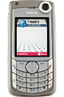
GSM: Components, Interfaces, Databases
radio cell
Components
MS= Mobile Station
BTS=Base Transceiver Station
BSC=Base Station Controller
MSC=Mobile Switching Centre
GMSC=Gateway MSC
OMC=Operation & Maintenance Centre
Interfaces
A interface : links MSC and BSC
Abis interface : links BSC and BTS
Um interface : radio link between BTS and MS
O interface : connects OMC to all elements
Databases
HLR=Home Location Register
VLR=Visitor Location register
EIR=Equipment Identity Register
AuC=Authentication Centre
MS
MS
radio cell
U_{m}
BTS
MS
RSS
U_{m}
BTS
A_{bis}
BSC
BSC
A
MSC
MSC
NSS
VLR
VLR
Signaling (SS7)
HLR
GMSC
ISDN, PSTN
O
PDN
OSS
EIR
AuC
OMC
Ref : Schiller, p101

Slide 23
GSM: system architecture
network and switching subsystem
(NSS)
radio subsystem (RSS)
fixed partner networks
MS
MS
ISDN PSTN
U_{m}
MSC
BTS
A_{bis}
BSC
EIR
BTS
SS7
Ref : Schiller
HLR
BTS
VLR
BSC
ISDN PSTN
BTS
A
MSC
BSS
IWF
PSPDN CSPDN

Slide 24
System architecture: radio subsystem
radio subsystem
network and switching subsystem
Components
MS (Mobile Station)
BSS (Base Station Subsystem): consisting of
BTS (Base Transceiver Station): sender and receiver
BSC (Base Station Controller): controlling several transceivers
Interfaces
U_{m} : radio interface
A_{bis} : standardized, open interface with 16 kbit/s user channels
A: standardized, open interface with 64 kbit/s user channels
MS
MS
U_{m}
BTS
A_{bis}
BSC
MSC
BTS
A
BTS
MSC
BSC
BTS
BSS
Ref : Schiller

Slide 25
Radio subsystem
The Radio Subsystem (RSS) comprises the cellular mobile network up to the switching centers
Components
Base Station Subsystem (BSS):
Base Transceiver Station (BTS): radio components including sender, receiver, antenna - if directed antennas are used one BTS can cover several cells
Base Station Controller (BSC): switching between BTSs, controlling BTSs, managing of network resources, mapping of radio channels (U_{m}) onto terrestrial channels (A interface)
BSS = BSC + sum(BTS) + interconnection
Mobile Stations (MS)
Ref : Schiller

Slide 26
GSM interfaces
Abis Interface
Interface between BTS and BSC
Non-standardised interface, manufacturers follow certain guidelines
Based on transmission of data on a PCM 30 interface (2.048Mb/s transmission rate partitioned into 32 channels of 64 kb/s each)
Voice compression can pack between 4 and 8 voice channels into single PCM 30 channel
A Interface
Interface between BSS and MSC
Standardised interface allows mixing of equipment from different manufacturers
A-Interface at physical level consists of two parts
First part between BSS and TRAU, transmission payload is still compressed
Second part between TRAU and MSC A-Interface at higher layers depends on SS7 MTP and
SCCP to carry BSSA

Slide 27
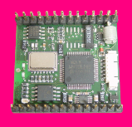
The Mobile Station (MS)
An MS is any fixed or mobile device which can be used to access the GSM network.
Five RF power levels are defined : 20W, 8W, 5W, 2W and 0.8W
RF power can be reduced in 2 dB steps down to 20 mW
BTS measures power and signals MS to change power in 2 dB steps every 13 TDMA frames (60 ms)
Tablets
& e-readers
Mobile Station
(MS)
Mobile Phone
Handsets
Laptops
Palmtops
& netbooks
Telemetry
modules

Slide 28
Mobile Station (MS) vs SIM
Every MS is uniquely identified by an IMEI (International Mobile Equipment Identity). One function of the IMEI is to verify the identity of the MS in the event of loss, theft or fraud.
The subscriber is uniquely identified by the Subscriber Identity Module (SIM) which is inserted into the MS, but can be removed and inserted into a different MS.
MSISDN - Mobile Subscriber ISDN Number is the number called by a party that wishes to contact the subscriber (the “phone number”).
IMSI - International Mobile Subscriber Identity identifies a subscriber inside the mobile network
TMSI - Temporary MSI used to enhance security
Billing and routing done on the basis of the subscriber not the equipment - using the SIM to identify the subscriber

Slide 29
Function of the MS
Voice and data transmission
digitising, encoding, error protecting, encrypting and modulation as well as inverse
Frequency and time synchronisation
MS tunes to a certain TDMA slot specified by the BSC
Monitoring signal strength and quality from surrounding cells
BER of synchronisation sequence of signals from <7 cells measured and communicated to BSC – contributes to handover calculations
Provision of location updates
periodic or forced - allows paging a MS in the correct LA
Equalisation of multipath distortions
adjusted every frame
Display of short messages (SMS)
Timing advance
calculated by BTS and required advance sent to MS

Slide 30
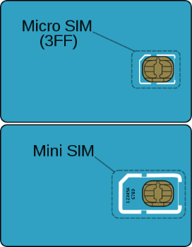
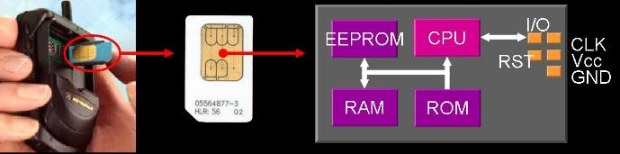
Subscriber Identification Module (SIM)
The SIM is a smart card which is inserted into the MS
The SIM contains a single chip computer with it’s own Operating System, File System, applications etc.
Smart Card contains security keys, network identifiers (IMSI, MSISDN) and algorithms
SIM security is protected by PIN
SIM can be moved from one MS to another.
SIM applications can be written with SIM Toolkit

Slide 31
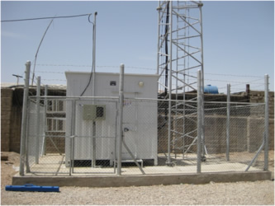
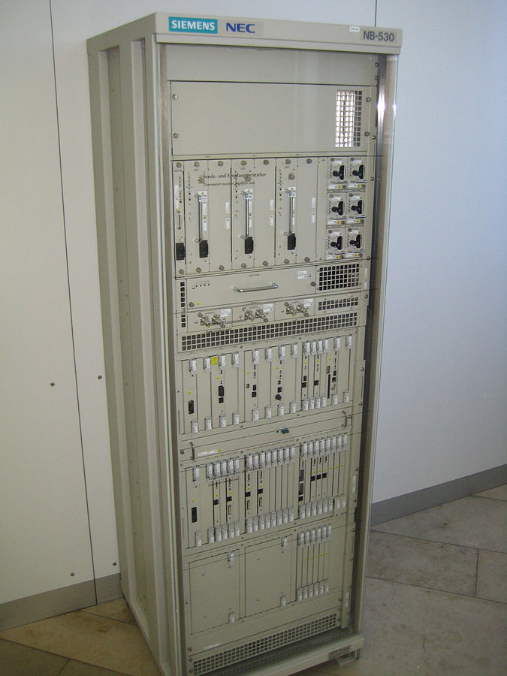
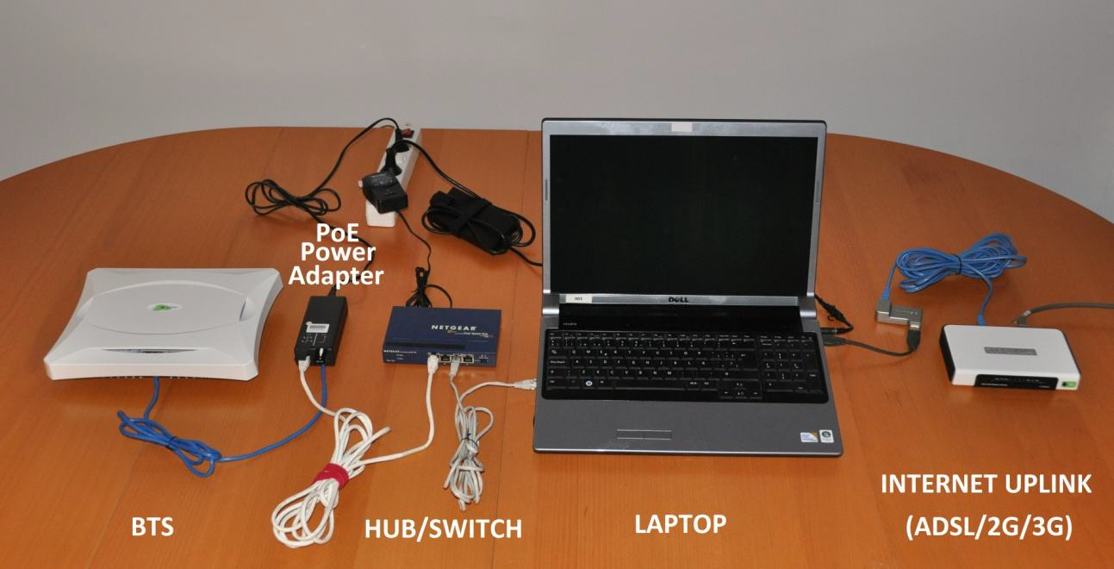
GSM BTS - Hardware

Slide 32
BTS vs BSC
Functions of the BTS :
Radio transmission and reception
Wireless channel encryption
Conversion between wired and wireless signals
Frequency Hopping
There is very little “intelligence” in the BTS
Functions of the BSC :
Controls several BTS
Locates the MS (paging)
Controls handovers
Translates GSM 13-Kbps voice to standard 64-Kbps format
Operation and maintenance functions of the BSS

Slide 33
BTS vs BSC : summary
Function | BTS | BSC
Management of radio channels |  | √
Frequency hopping | √ | √
Management of Terrestrial channels |  | √
Mapping of terrestrial channels onto radio channels |  | √
Channel coding and decoding | √
Rate adaption | √
Encryption and decryption | √ | √
Paging | √ | √
Uplink signal measurement | √
Traffic measurement |  | √
Authentication |  | √
Location registry, location update |  | √
Handover management |  | √
Ref : Schiller p103

Slide 34
Mobile Switching Centre (MSC)
The MSC is a critical central component of the network
MSC is basically a high performance telephony switch, which handles functions specific to mobile subscribers :
Registration
Authentication
Handover management
Billing (generation of CDR files)
A Gateway MSC (GMSC) handles interconnection with other networks (PSTN, ISDN etc.)

Slide 35
GSM Databases
HLR : “Home Location Register”
database of all users registered on that network (one HLR per network)
Stores current location of the subscriber
Regularly updated when MS changes location
VLR : “Visitor Location Register”
A database of all users and roamers in the geographic area.
Stores TMSIs and MSRNs
Caches the HLR
EIR : “Equipment Identity Register”
Stores the IMEI numbers for all MS on the network
AuC : “Authentication Centre”
Stores the authentication keys used for authorizing the subscriber access to the associated GSM PLMN.

Slide 36
Visitor Location Register (VLR)
The VLR temporarily stores information about the mobile stations that are active within a given MSC’s location area.
The HLR, VLR, and AuC comprise the management databases that support roaming (including international roaming) in the GSM network.
There is a VLR associated with each MSC in the network.
Having a local cache of HLR data in the VLR avoids frequent HLR database updates and long distance signalling of the user information, allowing faster access to subscriber information.

Slide 37
Role of the VLR in Roaming
When a new subscriber roams into a location area, the VLR copies subscriber information from the home network HLR to its local database.
The VLR is responsible for allocating a Mobile Station Roaming Number (MSRN) and Temporary Mobile Subscriber Identity (TMSI) to visiting roamers, when required to route incoming (MT) calls.

Slide 38
HLR and VLR Roaming Brief
Together the HLR and VLR support roaming in a GSM network.
VLR activated when a new subscriber roams into a location area.
Stores information about MSs active in that area.
Subscriber information copied from home HLR to location VLR.
Reduces long distance signalling of user information.
Allows faster access to subscriber information.
Prevents frequent HLR database updates.
VLR allocates two numbers to route incoming calls:
A Mobile Station Roaming Number (MSRN)
A Temporary Mobile Subscriber Identity (TMSI)
Notes:
The HLR and VLR are the primary management databases that support roaming in the GSM network, including international roaming.
The HLR holds temporary data, such as the current location area of the mobile station and its roaming number, both of which are necessary for setting up a connection. When a mobile user leaves the current location area, the temporary data in the HLR is immediately updated.
The VLR holds temporary information about subscribers and mobile stations that are active in the geographic area for which the VLR is responsible. When a mobile station roams into a new MSC area, the VLR of that MSC will request data regarding that mobile station from the HLR. The location VLR will then copy the information from the home HLR to its local database. Subsequently, if the mobile station makes a call, the VLR will have the info needed for setting up the call without having to interrogate the HLR each time. Having this local cache of HLR data in the VLR alleviates the need for frequent HLR database updates and avoids long distance signalling of the user information. It also enables faster access to subscriber information.
The VLR is responsible for allocating a Mobile Station Roaming Number and Temporary Mobile Subscriber Identity to visiting roamers, when required, to route incoming mobile terminating calls.

Slide 39
GSM location Hierarchy
GSM service area
Combination of all member countries where a GSM MS can be served
PLMN service area
Can be several within a country - links from a PLMN and other PLMN, PSTN or ISDN network done through gateway MSCs which are national or international transit exchanges
MSC service area
MS in one MSC service area at a time and details held in VLR
Location area (LA)
MS can move within the LA without updating its location in the VLR
Cell
Smallest unit of location in a GSM network. MS can be in only located in one cell at a time.

Slide 40
Other network elements : TRAU
TRAU = Transcoder Rate Adaptor Unit
Transcoding is the process of making the digitised voice signal compatible with standard PSTN 2 Mbit/s connections (E1).
Combines 4 13 kbit/s speech or 3.6/6/12 kbit/s data and multiplexes these up to 64 kbit/s
Synchronising data is added to each stream to raise the rate to 16 kbit/s before multiplexing
The TRAU can be at the BTS, BSC or MSC location but is functionally a part of the BSS

Slide 41
Other network elements : TRAU
The TRAU provides for conversion from GSM to ‘conventional’ digital telephony signal rates.
The TRAU may be variously positioned in the network, as indicated below
BTS
TRAU
BSC
MSC
BTS
TRAU
16 kb/s transmission
BSC
MSC
BTS
64 kb/s transmission
TRAU
BSC
MSC
Ref : I. Darwazeh

Slide 42
Other network elements : Echo canceller
Total GSM round-trip delay (encoding, decoding and signal processing) is about 180 ms)
Reflection at the 4-wire to 2-wire hybrid would be annoying for the MS user (although it is not a problem for a PSTN user)
The echo canceller at the interface between the MSC and the PSTN reduces the effects of this echo
Ref : I. Darwazeh

Slide 43
Location Management in GSM
In order for international roaming to work, the location of the MS must be known to the network (HLR) at all times. A mobile will update its location to it’s HLR when it detects a change in location area.
Areas of national networks are divided into location areas each with a unique Location Area Identity (LAI) broadcast on the BCCH.
Each location area has a mobile switching centre (MSC) with a Home Location Register (HLR) and a Visitor Location Register (VLR).

Slide 44
Location Update
Location updating is carried out via the fixed network using the following procedure:
The VLR issues a Mobile Subscriber Roaming Number (MSRN) to be associated with the actual mobile identity (i.e. the International Mobile Subscriber Identity – IMSI) over the radio path.
Both the IMSI and MSRN are conveyed to the subscriber’s HLR over the fixed SS7 network.
Information on the subscriber’s user-profile is conveyed from the subscriber’s HLR to the VLR.
The HLR now contains the subscriber’s telephone number, the mobile’s IMSI and the MSRN that points to the mobile’s actual location.

Slide 45
GSM Radio Interface
Notes:
So let’s start by looking at the motivations of LTE.

Slide 46
GSM Radio Interface (U_{m})
The GSM radio interface (Um) employs examples of the following :
SDMA : Cellular structure assigning an MS to a BTS
FDD : Separate frequencies for uplink and downlink
FDMA : Available frequency resource is divided into separate channels (e.g GSM900 has 124 channels, each 200kHz wide)
TDMA : Each frequency channel is divided into time frames that repeat every 4.615ms. TDMA frames are further divided into 8 time slots of 576.9μS duration.
Data is transmitted in bursts. Each burst consists of 148 bits and lasts for 546.5μS. The remaining 30.4μS is used as guard space to avoid overlap with other bursts.
Each physical channel has a raw data rate of 33.8kbps. Therefore, each radio carrier is capable of transmitting approximately 270kbps

Slide 47
Time Division Multiple Access (TDMA)
time
Concept:
channel is composed of a series of timeslots of periodicity. Different signal energies are distributed into different timeslots. The adjacent channel interference is restricted by connection choosing from time to time. So the useful signal is passed only in the specified timeslot.
User 3
User 2
User 1
Frequency
GSM adopts TDMA/FDMA mode
channel width: 200KHz
each channel has 8 timeslots

Slide 48
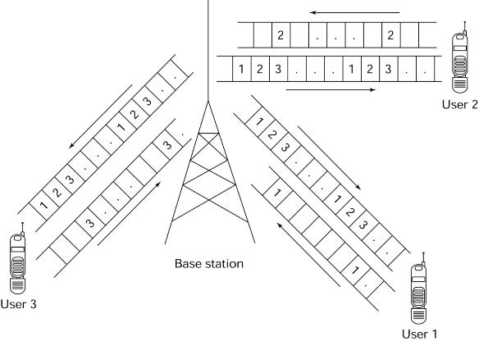
TDMA principle
GSM uses TDMA within each carrier
Each user occupies the entire carrier one time slot pr. time frame
8 slots per frame

Slide 49
GSM Timeslot and Frame structure
Frequency
200KHz
time
BP
15/26ms
interval

Slide 50
GSM Radio Interface : TDMA
Each frequency is divided up into 8 time slots, numbered 0 to 7.
Each time slot lasts 576.9 µs. A time slot is the basic radio resource used to facilitate communication between the MS and the BTS
Time slots are constructed into frames, each lasting 4.615ms (8 time slots plus guard spaces)
One physical channel consists of a single time slot, repeated every frame (i.e. repeated every 4.615ms).
Therefore, basic data rate of a single physical channel = 148/4.615ms = 32kbps
TS0
TS1
TS2
TS3
TS4
TS5
TS6
TS7
576.9 µs

Slide 51
GSM Radio Interface : TDMA/FDMA
935-960 MHz
124 channels (200 kHz)
downlink
frequency
890-915 MHz
124 channels (200 kHz)
uplink
higher GSM frame structures
time
GSM TDMA frame
1
2
3
4
5
6
7
8
4.615 ms
GSM time-slot (normal burst)
guard
space
guard
space
tail
user data
S
Training
S
user data
tail
3 bits
57 bits
1
26 bits
1
57 bits
3
546.5 µs
577 µs
Ref : Schiller, p109
Notes:
Each of the 248 channels is separated in time via a GSM TDMA frame, i.e., each 200 kHz carrier is subdivided into frames that are repeated continuously. The duration of a frame is 4.615 ms. A frame is further subdivided into 8 GSM time slots, where each slot represents a physical TDM channel and lasts for 577 μs. Each TDM channel occupies the full 200 kHz carrier for 577 μs every 4.615 ms.
Data is transmitted in bursts. The so-called normal burst as used for data transmission inside a time slot (user and signaling data). In the diagram, the burst is only 546.5 μs long and contains 148 bits. The remaining 30.5 μs are used as guard space to avoid overlapping with other bursts due to different path delays and to give the transmitter time to turn on and off. Filling the whole slot with data allows for the transmission of 156.25 bits within 577 μs. Each physical TDM channel therefore has a raw data rate of about 33.8 kbit/s, each radio carrier transmits approximately 270 kbit/s over the Um interface.
A physical channel therefore consists of a slot, repeated every 4.615 ms.

Slide 52
Timeslot and Frame structue
1 super high frame = 2048 super frame = 2715648 TDMA frame
0
1
2
3
2044
2045
2046
2047
BCCH
1 super frame = 1326 TDMA frame（6.12s）
CCCH
SACCH/TCH
SDCH
FACCH
0
1
2
3
47
48
49
50
0
1
24
25
1 multiplex frame = 26 TDMA frames（120ms）
1 multiplex frame = 51 TDMA frame
0
1
24
25
0
1
49
50
1 TDMA frame = 8 timeslot（120/26 = 4.615ms）
0
1
2
3
4
5
6
7

Slide 53
Physical Channel
0
1
2
3
4
5
6
7
8
9
10
11
12
13
14
15
16
17
18
19
20
21
22
23
The physical channel adopts FDMA and TDMA technologies.
In the time domain, a specified channel occupies the same timeslots in each TDMA frame, so it can be identified by the timeslot number and frame number.

Slide 54
GSM Channel structure
25 MHz
124 carriers
Burst period
Time slot 1
577 μs
Logical channels are built up of physical channels
Time slot 2
=Physical channel
…..
TDMA frame
= 4.615 ms
Time slot 8
Two types of logical channels are provided for in GSM :
Traffic Channels (TCH)
Transmit voice and data
Control Channels (CCH)
transmit the signaling and synchronous data between BTS and MS.

Slide 55
Logical vs Physical Channels
The physical medium is divided into 8*124 duplex channels (previous slide). These physical channels are mapped into Logical channels.
A specified logical channel occupies repeated timeslots in each TDMA frame. e.g. timeslot 3,11,18 etc.
For logical channels requiring higher data rates, multiple physical channels may be used for the same logical channel, e.g. 2,6,10,14,17,21.
0
1
2
3
4
5
6
7
8
9
10
11
12
13
14
15
16
16
17
18
19
20
21
22

Slide 56
Logical channels and frame hierarchy
Multiframes are frames that are grouped or linked together to perform specific functions.
Multiframes in the GSM system use established schedules for specific purposes, such as coordinating with frequency hopping patterns.
Multiframes used in the GSM system include the 26 traffic multiframe, 51 control multiframe, superframe, and hyperframe.

Slide 57
GSM hierarchy of frames
hyperframe
0
1
2
...
2045
2046
2047
3 h 28 min 53.76s
(= 2048 superframes)
superframe
0
1
2
...
48
49
50
6.12s (= 51 multiframes)
0
1
...
24
25
multiframe
0
1
...
24
25
120ms (= 26 frames)
0
1
2
...
48
49
50
235.4ms
frame
0
1
...
6
7
4.615ms (= 8 timeslots)
slot
burst
Timeslot = 576.92 µs
Ref : Schiller, p109

Slide 58
Superframe and Hyperframe
Superframe
A superframe is a multiframe sequence that combines the period of a 51 multiframe with 26 multiframes (6.12 seconds).
The use of the superframe time period allows all mobile devices to scan all the different time frame types at least once.
Hyperframe
A hyperframe is a multiframe sequence that is composed of 2048 superframes, and is the largest time interval in the GSM system (3 hours, 28 minutes, 53 seconds).
Every time slot during a hyperframe has a sequential number (represented by an 11 bit counter) that is composed of a frame number and a time slot number. This counter allows the hyperframe to synchronize frequency hopping sequence, encryption processes for voice privacy of subscribers' conversations.

Slide 59
GSM Logical Channel Hierarchy
GSM Channels
TCH
CCH
BCH
DCCH
CCCH
Data CH
Voice CH
14.4Kbit/s FR TCH (TCH/F14.4)
9.6Kbit/s FR TCH(TCH/F9.6)
4.8Kbit/s FR TCH (TCH/F4.8)
4.8Kbit/s HR TCH (TCH/H4.8)
FR Voice Traffic Channel (TCH/FS)
Enhanced FR Traffic Channel (TCH/EFR)
HR Traffic Channel (TCH/HS)
FCCH (down)
SCH (down)
BCCH (down)
SDCCH (up/down)
FACCH (up/down)
SACCH (up/down)
RACH (up)
AGCH (down)
PCH (down)

Slide 60
Traffic Channels (TCH)
GSM uses a TCH to transmit user data (e.g., voice, fax). Two basic categories of TCHs have been defined, :
full-rate TCH (T CH/F)
full-rate TCH (T CH/H)
With the voice codecs available at the beginning of the GSM standardization, 13 kbit/s were required, whereas the remaining capacity of the TCH/F (22.8 kbit/s) was used for error correction (TCH/FS).
Improved codes allow for better voice coding and can use a TCH/H. Using these TCH/Hs doubles the capacity of the GSM system for voice transmission. Speech quality decreases with the use of TCH/Hs, however, and many operators try to avoid using them.
The standard codecs for voice are called full rate (FR, 13 kbit/s) and half rate (HR, 5.6 kbit/s). A newer codec, enhanced full rate (EFR), provides better voice quality than FR as long as the transmission error rate is low. The generated data rate is only 12.2 kbit/s.
Notes:
Traffic channels (TCH): GSM uses a TCH to transmit user data (e.g., voice, fax). Two basic categories of TCHs have been defined, i.e., full-rate TCH (TCH/F) and half-rate TCH (TCH/H). A TCH/F has a data rate of 22.8 kbit/s, whereas TCH/H only has 11.4 kbit/s. With the voice codecs available at the beginning of the GSM standardization, 13 kbit/s were required, whereas the remaining capacity of the TCH/F (22.8 kbit/s) was used for error correction (TCH/FS). Improved codes allow for better voice coding and can use a TCH/H. Using these TCH/HSs doubles the capacity of the GSM system for voice transmission. However, speech quality decreases with the use of TCH/HS and many providers try to avoid using them. The standard codecs for voice are called full rate (FR, 13 kbit/s) and half rate (HR, 5.6 kbit/s). A newer codec, enhanced full rate (EFR), provides better voice quality than FR as long as the transmission error rate is low. The generated data rate is only 12.2 kbit/s. New codecs, which automatically choose the best mode of operation depending on the error rate (AMR, adaptive multi-rate), will be used together with 3G systems. An additional increase in voice quality is provided by the so-called tandem free operation (TFO). This mode can be used if two MSs exchange voice data. In this case, coding to and from PCM encoded voice (standard in ISDN) can be skipped and the GSM encoded voice data is directly exchanged. Data transmission in GSM is possible at many different data rates, e.g., TCH/F4.8 for 4.8 kbit/s, TCH/F9.6 for 9.6 kbit/s, and, as a newer specification, TCH/F14.4 for 14.4 kbit/s. These logical channels

Slide 61
Broadcast channels (BCH)
The BCH channels are used, by the base station, to provide the mobile station with the sufficient information it needs to synchronize with the network. There are 3 subchannels of the BCH as follows :
Broadcast Control Channel (BCCH) :A BTS uses this channel to signal information to all MSs within a cell. information transmitted in this channel is, e.g., the cell identifier, options available within this cell (frequency hopping), and frequencies available inside the cell and in neighbouring cells.
Synchronization Channel (SCH) : Supplies the mobile station with the training sequence needed in order to demodulate the information transmitted by the base station
Frequency-Correction Channel (FCCH) : Supplies the mobile station with the frequency reference of the system in order to synchronize it with the network

Slide 62
Common Control Channels (CCCH)
All information regarding connection setup between MS and BS is exchanged via the CCCH. The subchannels of the CCCH are as follows :
Paging CHannel (PCH) : The BTS uses the paging channel (PCH) for paging the appropriate MS in order to set up a mobile terminated (MT) call.
Random Access Channel (RACH) : lf an MS wants to set up a call, it uses the random access channel (RACH) to send data to the BTS. The RACH implements multiple access (all MSs within a cell may access this channel) using slotted Aloha. This is where a collision may occur with other MSs in a GSM system.
Access Grant CHannel (AGCH) : The BTS uses the access grant channel (AGCH) to signal an MS that it can use a TCll or SDCCH for further connection setup.

Slide 63
Dedicated Control Channels (DCCH)
While the previous channels have all been unidirectional, the following channels are bidirectional.
As long as an MS has not established a TCH with the BTS, it uses the Stand-alone Dedicated Control CHannel (SDCCH) with a low data rate (782 bit/s) for signaling. This can comprise authentication, registration or other data needed for setting up a TCH.
Each TCH and SDCCH has a Slow Associated Dedicated Control CHannel (SACCH) associated with it, which is used to exchange system information, such as the channel quality and signal power level.
Finally, if more signaling information needs to be transmitted and a TCH already exists, GSM uses a Fast Associated dedicated Control CHannel (FACCH). The FACCH uses the time slots which are otherwise used by the TCH. This is necessary in the case of handovers where BTS and MS have to exchange larger amounts of data in less time.

Slide 64
Fast Associated Control Channel Signalling
The GSM Fast Associated Control Channel (FACCH) is transmitted by “stealing” speech frames and replacing them with control information.
The FACCH message is divided and transmitted over 8 sequential channel bursts and the speech information that would normally be transmitted is discarded.
When received, the FACCH message is reassembled into its original message structure.
Since the proportion of speech data stolen and discarded is small, the effect on voice quality is not noticable.
8 frames (approx 37ms)
Original
FAACH
message
Speech
Bits
discarded
Reassembled
FAACH
message

Slide 65
Mapping of Physical Channels in GSM
There are 5 types of burst that can occupy a timeslot:
(1) Normal burst (148 bits + 8.25 guard bits).
(2) Frequency correction Burst (148 bits + 8.25 guard bits).
(3) Synchronisation burst (148 bits + 8.25 guard bits).
Random access burst (88 bits + 68.25 guard bits).
Idle burst
A normal burst consists of 148 bits transmitted at 270.833 kb/s: 114 bits are available for data transmission, 26 bits are used for the equaliser training sequence, 3 Head and 3 Tail bits ensure equalisation of data bits close to the burst edges.
A guard time of 8.25 bits is added at the end of each burst to prevent transmitted bursts from different mobiles overlapping., as a result of their differing distances from the base station.
Two stealing flags (SF) indicate that a TCH has been stolen for signalling purposes.
If slow frequency hopping is implemented then the frequency is changed between bursts using those frequency channels available in the serving cell.

Slide 66
GSM Normal Burst
logical channels are mapped onto the basic TDMA frame structure below and the recurrence of one particular timeslot on each frame constitutes one physical channel.
The GSM normal burst is used for the standard communications between the base station and the Mobile Stations, and is used to carry both TCH and CCH data.
0
1
2
3
4
5
6
7
8
9
10
11
12
13
14
15
16
17
18
19
20
21
22
23
24
25
26 frame length: 120 ms
BP0
BP1
BP2
BP3
BP4
BP5
BP6
BP7
TDMA frame length: 4.6 ms
3
57
1
26
1
57
3
8.25
Header bits
Data bits
Flag
Training sequence
Flag
Data bits
Tail bits
Guard Time
156.25 bits (0.577 ms)

Slide 67
GSM Normal Burst
3 header bits: These bits at the start of the GSM burst give time for the transmitter to ramp up its power
57 data bits: This block of data is used to carry information, and most often contains the digitised voice data although on occasions it may be replaced with signalling information in the form of the Fast Associated Control CHannel (FACCH). The type of data is indicated by the flag that follows the data field
1 bit flag (steal bit): This bit within the GSM burst indicates the type of data in the previous field.
26 bits training sequence: This is used by the receiver’s equalizer as it estimates the transfer characteristic of the physical path between the BTS and the MS.
1 bit flag: This flag indicates the type of data in the following data field.
57 data bits: Used for carrying payload data.
3 tail bits: These final bits within the GSM burst are used to enable the transmitter power to ramp down. They are often called final tail bits, or just tail bits.
8.25 bits guard time: At the end of the GSM burst there is a guard period. This is introduced to prevent transmitted bursts from different mobiles overlapping, as a result of their differing distances from the base station.
3
57
1
26
1
57
3
8.25
Header bits
Data bits
Flag
Training sequence
Flag
Data bits
Tail bits
Guard Time

Slide 68
GSM Synchronisation Burst
The Synchronisation burst provides synchronisation for all the Mobile Stations on the network :
3 header bits: header bits at the start of the GSM burst give time for the transmitter to ramp up its power
39 bits: of data.
64 bits: of a Long Training Sequence:
39 bits: of data.
3 tail bits: these are to enable the transmitter power to ramp down.
8.25 bits guard time to act as a guard interval.
3
39
64
39
3
8.25
Data bits
Training sequence
Data bits
Guard Time
Header bits
Tail bits

Slide 69
GSM Frequency Correction Burst
The Frequency correction burst essentially consists of a constant frequency carrier with no phase alteration (data is all zeros)
3 header bits: header bits at the start of the GSM burst give time for the transmitter to ramp up its power.
142 bits: data bits all set to zero:
3 tail bits: to enable the transmitter power to ramp down.
8.25 bits: guard time to act as a guard interval
3
142
3
8.25
Header bits
All zero data
Tail bits
Guard Time

Slide 70
GSM Random Access Burst
The GSM random access burst is used when the MS is accessing the network and it is shortened in terms of the data carried, having a much longer guard period.
This GSM burst structure is used to ensure that it fits in the time slot regardless of any severe timing problems that may exist. Once the mobile has accessed the network and timing has been aligned, then there is no requirement for the long guard period.
7 header bits: The increased number of header bits is included to provide additional margin when accessing the network.
41 training bits: Longer training sequence than normal.
36 bits: of data.
3 tail bits: Again these are to enable the transmitter power to ramp down.
69.25 bits guard time: Much longer than normal guard time allows for large timing differences
7
41
36
3
69.25
Header bits
Training sequence
Data bits
Tail bits
Guard time

Slide 71
Example of use of bursts: registration
Power on
Scan channels,
monitor RF
levels
Select channel with highest
RF level among control CHs
FCCH scan
Select CH With next highest
RF level from control list
NO
FCCH detected
YES
SCH scan
NO
SCH detected
YES
Read data from BCCH )
NO
.
From the CH data update the
control CH list
Correct BCCH
YES
Camp on BCCH and start decoding

Slide 72
Mapping of Physical Channels in GSM
The basic TDMA frame applies to both uplink and downlink. However, the slot numbers are staggered by three slots so that the mobile does not transmit and receive at the same time.
GSM Slots and Scanning Structure

Slide 73
Mapping of Logical Channels in GSM
Five different cases of mapping logical channels onto one physical channel are used in GSM as follows:
One full-rate TCH and its SACCH.
Two half-rate TCHs (HTCH) and their SACCH.
BCCH and CCCH.
Eight SDCCH.
Four SDCCH, one BCCH and one CCCH (this for lower capacity than case (3)).
In order to achieve these mappings two multiframe formats are used:
Multiframe Format (1) :
26 TDM frames for the TCH/SACCH cases (1) and (2)
Multiframe Format (2) :
51 TDM frames for cases (3), (4) and (5).

Slide 74
Channel Assignment inside cells
Small capacity cell with only 1 TRX
TN0: FCCH+SCH+CCCH+BCCH+SDCCH/4(0,_,3)+SACCH/C4(0,_,3);
TN1-7: TCH/F+FACCH/F+SACCH/TF
The medium-size cell with 4 TRXs
1TN0 group: FCCH+SCH+BCCH+CCCH;
2 SDCCH/8(0,_,7)+SACCH/C8(0,_,7);
29 TCH/F+FACCH/F+SACCH/TF
Large-size cell with 12 TRXs
1 TN0 group: FCCH+SCH+BCCH+CCCH;
1 TN2 group, 1 TN4 group and 1 TN6 group: BCCH+CCCH;
5 SDCCH/8(0,_,7)+SACCH/C8(0,_,7);
87 TCH/F+FACCH/F+SACCH/TF

Slide 75
Mapping of TCH and SACCH
Full- and Half-Rate Channels
In the diagram TC0 denotes a normal burst of 0.577 ms (associated with a TDMA frame) on a physical channel. TC1 denotes the next burst occurring 4.615 ms later on the same physical channel and so on. The multiframe duration equals
26 × 4.615 ms = 120 ms.

Slide 76
Mapping of TCH and SACCH
The gross bit rate per TCH is derived as follows:
Data bits per normal burst = 114 bits
Normal bursts per 120 ms Multiframe = 24
Gross Bit Rate = 24  114 / 0.12 = 22.8 kb/s
SACCH uses 114 bits per 120 ms = 950 b/s
For the HTCH, two half-rate channels share one physical channel and the SACCH associated with the second HTCH occupies the idle frame. Hence, each HTCH occupies 12 frames with a gross bit rate of 11.4 kb/s while each SACCH uses 950 b/s.
The FACCH uses the TCH as indicated by the stealing flags.

Slide 77
Mapping of BCCH and CCCH
R
C
I
Multiframe Structure
This multiframe format is carried by timeslot 0 on one of the allocated carriers in the serving cell called the BCCH carrier. On the uplink the mobile can use any one of the 51 frames in timeslot 0 to access the network. On the downlink the 51 frames are grouped into 5 sets of 10 frames (the 51st slot is idle).

Slide 78
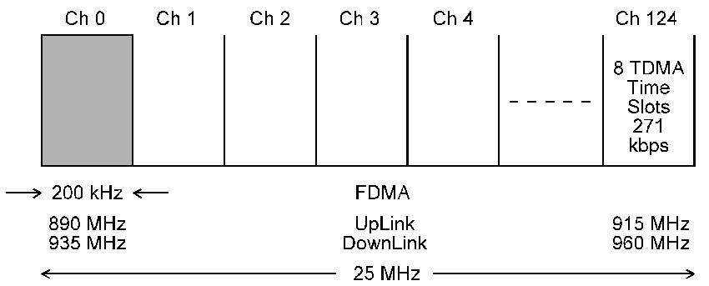
GSM Radio Interface : FDMA
GSM uses Frequency Division Duplexing (FDMA) to separate the uplink and downlinks.
FDD requires two distinct frequency bands; 890MHz to 915MHz for the uplink (MS to BTS) and 935MHz to 960MHz for the downlink (BTS to MS).
Channel separation is 200kHz, meaning that there are 125 channels in each of the above frequency bands.
Each cell can have 1 to 15 pairs of carriers and each carrier is time multiplexed into 8 slots. A physical channel therefore consists of a carrier frequency and a timeslot.

Slide 79
Absolute Radio Frequency Channel Number
Each uplink/downlink pair is assigned a number called the Absolute Radio Frequency Channel Number (ARFCN).
The uplink and downlink frequencies each have a bandwidth of 200 kHz. The uplink and downlink have a specific offset that varies for each band. The offset is the frequency separation of the uplink from the downlink.
Every time the ARFCN is incremented, the uplink increases by 200 kHz and the downlink also increases by 200 kHz.
An ARFCN has an allowed bandwidth of 200 kHz, which corresponds exactly to the carrier separation.
The frequency of the ARFCN refers to its centre frequency. For example, if an ARFCN has a frequency of 914.80 MHz, then it occupies the frequency space from 914.7 MHz to 914.9 MHz (200 kHz total).

Slide 80
ARFCN for various GSM standards
 | GSM 450 | EGSM 450 | GSM 850 | GSM 900 | EGSM 900 | GSM 1800 | GSM 1900
Uplink Frequency Range | 450 to 458 MHz | 478 to 486 MHz | 824 to 849 MHz | 890 to 915 MHz | 880 to 915 MHz | 1710 to 1785 MHz | 1850 to 1910 MHz
Downlink Frequency Range | 460 to 468 MHz | 488 to 496 MHz | 869 to 894 MHz | 935 to 960 MHz | 925 to 960 MHz | 1850 to 1880 MHz | 1930 to 1990 MHz
ARFCN | 259 - 293 | 306 - 340 | 128 - 251 | 1 - 124 | 0 – 124, 975 - 1023 | 512 - 885 | 512 - 810
Offset | 10MHz | 10MHz | 45MHz | 45MHz | 45MHz | 95MHz | 80MHz

Slide 81
GSM Coding and Modulation
Coding and Decoding in GSM
The various stages of coding and decoding in a GSM TCH are shown above. The speech codec operates at 13 kb/s since speech is encoded into 260 bit frames of 20 ms duration. Each 260 bit frame is then channel encoded using block and convolutional codes to give a 456 bit frame.

Slide 82
Discontinuous Transmission and Reception
An average speech activity of just 44% means that a voice activity detector (VAD) can be used to suppress TCH transmission during silent periods.
This reduces the level of co-channel interference by 3 dB on average and prolongs battery life.
The silent periods are filled with low level comfort noise to remove the impression that the link has been disconnected.
Since the mobile need only listen to a subset of all paging frames, then in the remaining time it can switch to stand-by-mode, thereby conserving power. This process is called discontinuous reception.

Slide 83
GSM Coding and Modulation (contd.)
The 456 bit frame is subdivided into 8  57 bit blocks which are interleaved to a depth of 8. The process of channel coding and interleaving is shown below.

Slide 84
GSM Speech Path
Transmit Path
Receive Path
Speech
Speech
Low bit rate speech coding
Low bit rate speech decoding
13 Kbps
13 Kbps
Channel coding
Channel decoding
22.8 Kbps
22.8 Kbps
Bit interleaving
Bit Deinterleaving
22.8 Kbps
22.8 Kbps
Encryption
Decryption
Overhead
Burst Building & Multiplexing
Demultiplexing
Overhead
33.6 Kbps
Delay Equalisation
33.6 Kbps
33.6 Kbps
Carrier Modulation
Carrier Demodulation
Radio Channel (Um)
270.83 Kbps

Slide 85
Speech Coding at Mobile Side
PCM with Uniform Quantisation
Speech Waveform
Volts
Time
160 samples in a 20 ms frame
Quantise samples
into specific levels
and encode into
13-bit values
Quantising
Levels (8192)
13 bits
sample
8000 sps x = 104000bps

Slide 86
GSM Speech Processing : MS side
Transmit path
To
Channel
Coder
104 kbps
Speech
Encoder
LPF
A/D
uniform
mouthpiece
Receive path
From
Channel
Decoder
104 kbps
Speech
Decoder
LPF
D/A
uniform
earpiece

Slide 87
GSM Speech Coding at Network Side
Transcoding Process
Speech Waveform
Volts
Time
160 samples in a 20 ms frame
A-law
256
levels
Uniform
8192
levels
64 kbps
104 kbps

Slide 88
GSM Speech Processing : Network side
Transmit path
8-bit A-law
to 13-bit uniform
transcoder
Speech encoder
To
Channel
Coder
64 kbps
104 kbps
Digital
Speech
Input
uniform
Receive path
13-bit uniform
to 8-bit A-law
transcoder
Speech decoder
From
Channel
Coder
64 kbps
104 kbps
Digital
Speech
Output
uniform

Slide 89
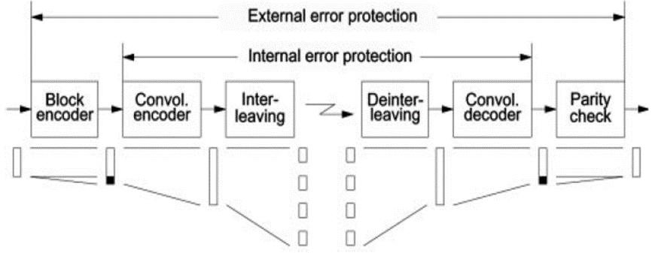
GSM Channel Coding
GSM Channel Coding Uses Several procedures:
Block Coding
generates parity bits for error detection.
Convolution Coding
generates redundancy for error Correction.
Interleaving
Interleaving of data over several blocks reduces the
damage done by burst error

Slide 90
Channel Coding for Full-rate Speech in GSM
4 tail bits
ACELP
Speech encoder
50 Most
Significant
Class 1 bits
Bit interleaver
(8 burts)
3 bits
1/2 Rate
Convolutional
Coder
3 bit CRC
Coded
Class 1 bits
160 Speech
Samples
260 bits
(20 ms)
Class 1 bits
378 bits
182 bits
456 bits
(20 ms)
Class II bits
78 bits

Slide 91
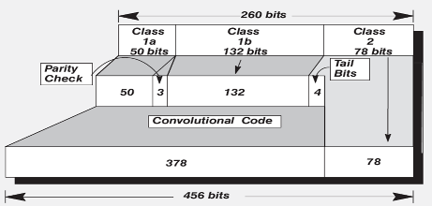
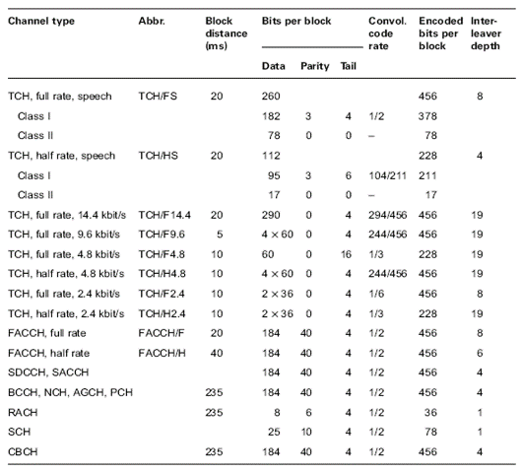
Coding in GSM
For Full Rate Speech 260 bits are transmitted in 20ms equalling a transmission rate of 13 kbps and encoded in blocks according to respective importance to the of speech intelligibility.
Class 1a
50 class 1a bits.
3 parity bits are generated on these bits.
These are most important bits.
Class 1b
132 class 1b bits.
Not parity checked
4 tail bits are added to this class.
Class 2
78 bits least important
Not protected at all.

Slide 92
Interleaving
In mobile communications, the errors are “bursty”
Optimal performance from ECC is obtained for uniform error distribution
Interleaving increases the performance of ECC in mobile environment

Slide 93
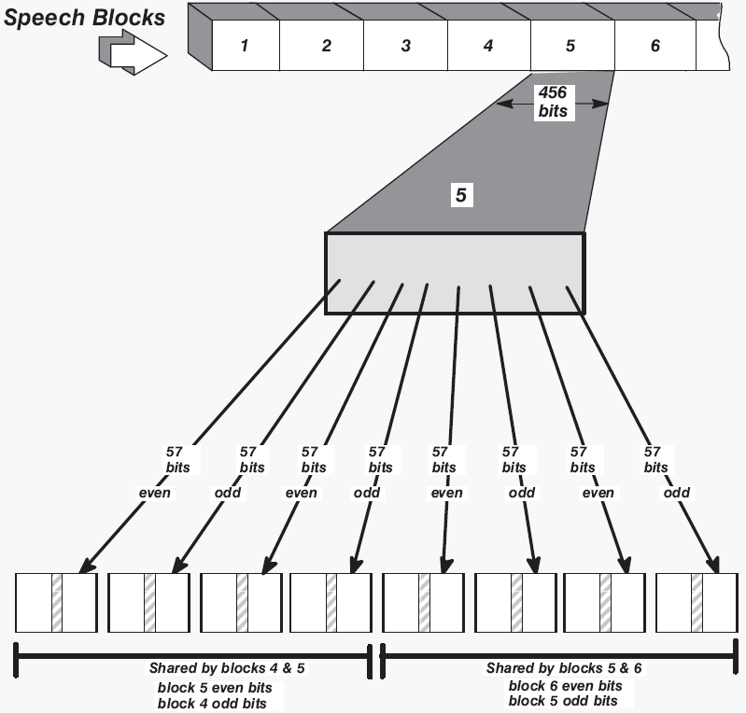
After channel encoding, the next step is to build its bit stream into bursts to be transmitted within TDMA frame structure.
Interleaving spreads the content of one traffic block across several TDMA timeslots.
Interleaving depths/typed used:
Speech – 8 blocks/ Diagonal
Control – 4 blocks/Rectangular
Data – 22 blocks/Hybrid

Slide 94
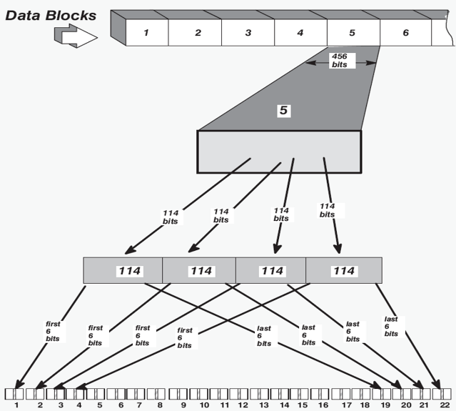
Hybrid Interleaving
Data channels encoded previously to 456 bits are divided into blocks of four 114 bit each. These blocks are then interleaved together.
The first 6 bits from the first block are placed in the first burst, the 2nd 6 from block in the 2nd burst and so on. Each 114 bits will be spread across 19 bursts and total 456 across 22 bursts.

Slide 95
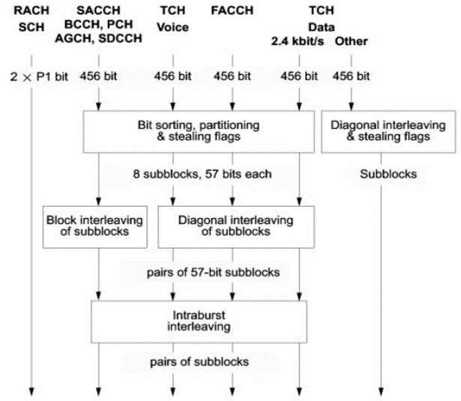
Interleaving processes

Slide 96
Discontinuous Transmission and Reception
An average speech activity of just 44% means that a Voice Activity Detector (VAD) can be used to suppress TCH transmission during silent periods.
This reduces the level of co-channel interference by 3 dB on average and prolongs battery life.
The silent periods are filled with low level comfort noise to remove the impression that the link has been disconnected.
Since the mobile need only listen to a subset of all paging frames, then in the remaining time it can switch to stand-by-mode, thereby conserving power. This process is called discontinuous reception.

Slide 97
GSM AMR codec
Adaptive Multi-rate (AMR) codec is now the most widely used GSM codec.
The AMR codec was adopted by 3GPP in October 1988 and it is now widely used for both GSM and circuit switched UMTS / WCDMA voice calls.
The AMR codec provides a variety of options for one of eight different bit rates as described in the table below.
The bit rates are based on frames that are 20 millisceonds long and contain 160 samples.
Discontinuous transmission is employed so that when there is no speech activity the transmission is cut. Additionally Voice Activity Detection (VAD) is used to indicate when there is only background noise and no speech. To provide audio feedback to indicate to the user that the connection is still present, a Comfort Noise Generator (CNG) is used to provide some background noise, even when no speech data is being transmitted. This is added locally at the receiver.
Mode | Bit Rate (kbps) | Full/Half rate
AMR 12.2 | 12.2 | FR
AMR 10.2 | 10.2 | FR
AMR 7.95 | 7.95 | FR / HR
AMR 7.40 | 7.4 | FR / HR
AMR 6.70 | 6.7 | FR / HR
AMR 5.90 | 5.9 | FR / HR
AMR 5.15 | 5.15 | FR / HR
AMR 4.75 | 4.75 | FR / HR

Slide 98
Modulation
Considerations upon choosing modulations scheme:
Spectral efficiency
Error performance (power and noise relations)
Out of band emission (rapid drop off desired to limit adjacent channel interference)
Constant envelope desired for low cost amplifiers, e.g. in handheld equipment
Always a trade off
In GSM: GMSK – Gaussian Minimum Shift Keying is used

Slide 99
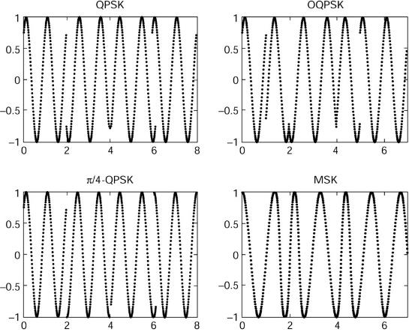
GMSK Modulation
MSK can be considered as a development of QPSK but without the abrupt discontinuities at phase transitions.
MSK is an example of continuous phase modulation
The constant amplitude envelope of MSK results in relatively low sidelobes

Slide 100
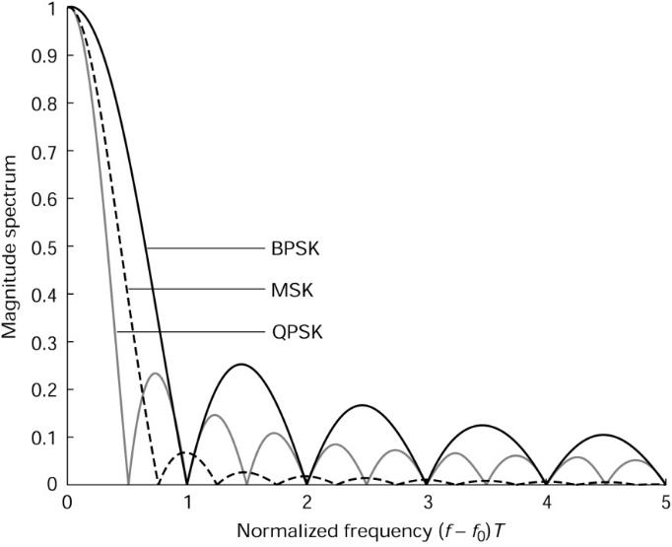
GMSK Modulation
Spectrum of MSK, QPSK and BPSK

Slide 101
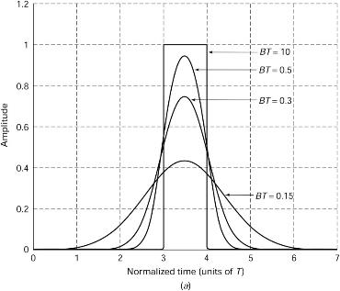
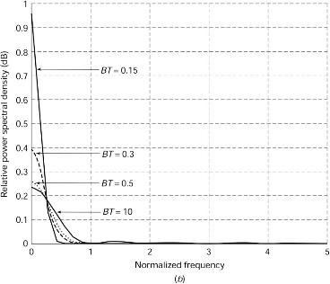
GMSK Modulation
GMSK further reduces sidelobes by using a Gaussian filter
Cost: introduces inter-symbol-interference (ISI)
Figures show time and frequency response
GSM uses BT = 0.3

Slide 102
Gaussian Minimum Shift Keying (GMSK)
To appreciate GMSK we must first consider Minimum Shift Keying (MSK) implemented using quadrature modulation. MSK is a special form of binary frequency shift keying (FSK) using a frequency deviation f_{d} = 1/4T , where T is the bit duration.
cos()
Quadrature Modulator
cos(2πf_{c}t)
s_{msk}(t)
d(t)
A
sin(2πf_{c}t)
2πf_{d}
sin()

Slide 103
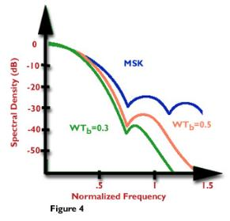
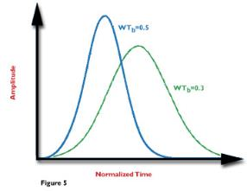
Gaussian Minimum Shift Keying (Contd.)
To obtain GMSK, the data d(t) is pre-filtered by a Gaussian shaped filter:
where
In GSM the BT = 0.3, which defines B for a given T and hence α .
The bit error rate of GMSK is given by:
where γ = 0.68 for BT = 0.25 and indicates the degradation in BER due to the ISI introduced by the Gaussian filter.
h_{g}(t)
MSK
Quad.Mod
s_{gmsk}(t)
GMSK PSD
d(t)
Gaussian Pulse Shape
WT = BT!

Slide 104
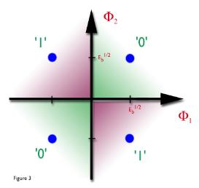
Gaussian Minimum Shift Keying (contd.)
GMSK is an example of a constant amplitude, continuous phase modulation scheme which is characterised by:
1) Bandwidth efficient;
2) Low out-of-band sidelobes;
3) Low distortion and spectral regrowth in presence of PA non-linearity.
The purpose of Gaussian filtering is to reduce the out of band sidelobe energy caused by the sudden change in carrier frequency associated with bit transitions. The presence of the Gaussian filter constrains the rate of change of frequency at a bit transition as shown in the above diagram. The GMSK waveform as well as showing constant amplitude and continuous phase also shows smoothed frequency changes.
GMSK Constellation
GMSK Waveform

